Slide 1
Chapter 3: Inter Process Communication (IPC)

Slide 2
Interprocess Communication
Processes within a system may be independent or cooperating
Cooperating process can affect or be affected by other processes, including sharing data
Reasons for cooperating processes:
  Information sharing
  Computation speedup
  Modularity
  Convenience
Cooperating processes need interprocess communication (IPC)
Two models of IPC
  Shared memory
  Message passing

Slide 3

Communications Models
(a) Message passing. (b) shared memory.

Slide 4
Interprocess Communication – Shared Memory
An area of memory shared among the processes that wish to communicate
The communication is under the control of the users processes not the operating system.
Major issues is to provide mechanism that will allow the user processes to synchronize their actions when they access shared memory.
Synchronization is needed, which will be discussed in great details in Chapter 5.

Slide 5
Interprocess Communication – Message Passing
Mechanism for processes to communicate and to synchronize their actions
Message system – processes communicate with each other without resorting to shared variables
IPC facility provides two operations:
  send(message)
  receive(message)
The message size is either fixed or variable

Slide 6
Message Passing (Cont.)
If processes P and Q wish to communicate, they need to:
  Establish a communication link between them
  Exchange messages via send/receive
Implementation of communication link
  Physical:
    Shared memory
    Hardware bus
    Network
  Logical:
    Direct or indirect
    Synchronous or asynchronous
    Automatic or explicit buffering

Slide 7
Direct Communication
Processes must name each other explicitly:
  send (P, message) – send a message to process P
  receive(Q, message) – receive a message from process Q
Properties of communication link
  Links are established automatically
  A link is associated with exactly one pair of communicating processes
  Between each pair there exists exactly one link
  The link may be unidirectional, but is usually bi-directional

Slide 8
Indirect Communication
Messages are directed and received from mailboxes (also referred to as ports)
  Each mailbox has a unique id
  Processes can communicate only if they share a mailbox
Properties of communication link
  Link established only if processes share a common mailbox
  A link may be associated with many processes
  Each pair of processes may share several communication links
Operations
  create a new mailbox (port)
  send and receive messages through mailbox
  destroy a mailbox
Primitives are defined as:
send(A, message) – send a message to mailbox A
receive(A, message) – receive a message from mailbox A

Slide 9
Indirect Communication
Mailbox sharing
  P₁, P₂, and P₃ share mailbox A
  P₁, sends; P₂ and P₃ receive
  Who gets the message?
Solutions
  Allow a link to be associated with at most two processes
  Allow only one process at a time to execute a receive operation
  Allow the system to select arbitrarily the receiver. Sender is notified who the receiver was.

Slide 10
Communications in Client-Server Systems
Pipes
Sockets
Remote Procedure Calls
Remote Method Invocation (Java)

Slide 11
Pipes
Acts as a conduit allowing two processes to communicate
Questions:
  Is communication unidirectional or bidirectional?
  Must there exist a relationship (i.e., parent-child) between the communicating processes?
Ordinary pipes – cannot be accessed from outside the process that created it. Typically, a parent process creates a pipe and uses it to communicate with a child process that it created.
Named pipes – can be accessed without a parent-child relationship.

Slide 12
Pipes
* Pipe
A simple, unnamed pipe provides a one-way flow of data.
  Can be thought as a special file that can store a limited amount of data in a first-in-first-out manner, exactly akin to a queue.
Other variations:
    Stream pipes
    FIFOs
An unnamed pipe is created by calling pipe(), which returns an array of 2 file descriptors (int).
  The file descriptors are for reading and writing, respectively

Slide 13
pipe System Call (unnamed)
Creates a half-duplex pipe.
Include(s): < unistd.h>
Syntax: int pipe (int pipefd[2]);
Return: Success: 0; Failure: -1; Sets errno: Yes
  What does it mean to return errno?
Arguments: None
If successful, the pipe system call will return two integer file descriptors, pipefd[0] and pipefd[1].
  pipefd[1] is the write end to the pipe.
  pipefd[0] is the read end from the pipe.
Parent/child processes communicating via unnamed pipe.

Slide 14
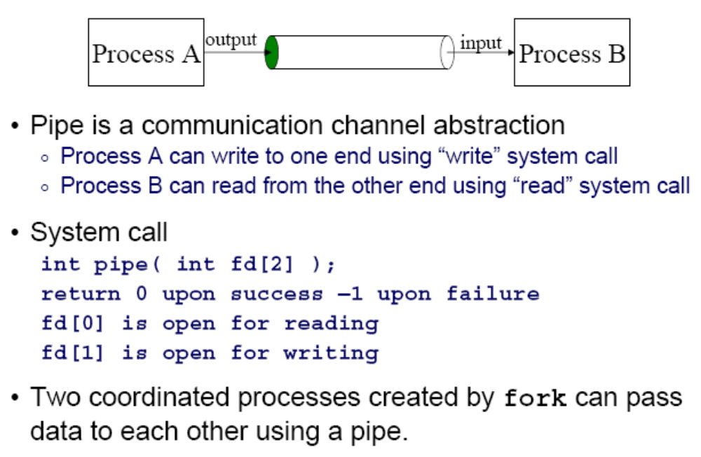
Creating a Pipe

Slide 15
Piping Between Two Processes
The pipe is represented in an array of 2 file descriptors (int)
Writing process Reading process
read fd₀
write fd₁
pipe
flow of data

Slide 16
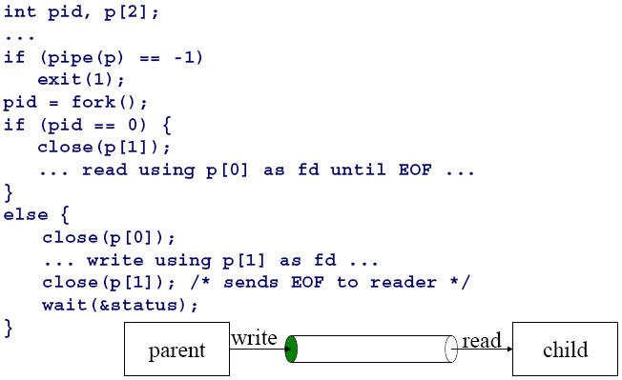
Pipe Example
child
parent

Slide 17
Full Duplex Channel via Two Pipes
Two separate pipes, say p0 and p1
Process A Process B
write p0₁ write p1₁
read p1₀ read p0₀
p0
p1

Slide 18
write System Call
Function:
To write nbytes to the write end of a pipe.
  If a write process attempts to write to a full pipe, the default action is for the system to block the process until the data is able to be received.
Include(s): <unistd.h>
Syntax: ssize_t write (int fd, const void *buf, size_t nbytes);
  just the write system call
Returns
  success: Number of bytes written; Failure; -1; Sets errno:Yes.
Arguments
  int fd: file descriptor;
  const void *buf: buffer;
  size_t nbyte: number of bytes in buffer

Slide 19
read System Call
Function:
To read nbytes from the read end of a pipe.
  if read is attempted on an empty pipe, the process will block until data is available.
Includes: <unistd.h> <sys/types.h> <sys/uio.h>
Syntax: ssize_t read(int fd, const void *buf, size_t nbytes);
Return
  success: Number of bytes read;
  Failure; -1; Sets errno:Yes.
  EOF (0): write end of pipe closed
Arguments
  int fildes: file descriptor;
  const void *buf: buffer;
  size_t nbyte: number of bytes

Slide 20
Hands-on Practice
Question 4 in Project 1
Code structure (pseudocode):
pid = fork();
int pipe[2];
if (pid < 0)
error….;
else if (pid == 0)
read from pipe[0];
MyCompress();
write to destination txt;
else
read from source txt;
write to pipe[1];
pid = fork();
int pipe[2];
if (pid < 0)
error….;
else if (pid == 0)
read from pipe[0];
write to destination txt;
else
read from source txt;
MyCompress();
write to pipe[1];
Or

